Slide 1
Value Realization Framework
Overview for the BSC team
23 Nov 2010

Slide 2
The Problem
Business strategy and goals may be well understood but traceability is not clearly demonstrated in the IT Strategy, prioritization of activities and level of investment
Value prediction is based on “best guesses” with little if any basis in historical evidence
Value realized from IT investments is seldom measured and as such the value of IT is unknown
IT activity is slow to reflect changes in the business strategy
Customer’s do not believe they get the full ROI from their Microsoft investment

Slide 3
Value Realization Framework
Demonstrated
business value
Value Realization
Initiative Planning
360 Assessment
Program of change
and value prediction
Agreement to plan
The Value Realization Framework provides Enterprise Architects with an information centric set of process and transformations for describing and implementing a value driven program of change that leverages Microsoft solutions.

Slide 4
Value Realization Framework
Demonstrated
business value
Value Realization
Initiative Planning
Assessment
Program of change
and value prediction
Agreement to plan
The Value Realization Framework provides Enterprise Architects with an information centric set of process and transformations for describing and implementing a value driven program of change that leverages Microsoft solutions.

Slide 5
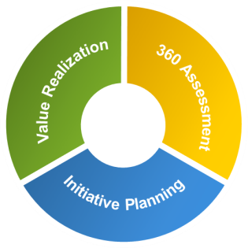
Enterprise Strategy Program
Program Benefits
Offerings
Set of service packages
End-to-end experience
Global Operating Model
Strategic Briefings
Envisioning Workshops
Customer Connection Programs
Defines Structure
Initiative
Planning
Value
Realization
Foundation for Content
Rich IP and content harvested globally
Seamless integrated experience
Globally accessible network of people and services
Leveraged for Sharing
Value Realization Framework
Library and Network
Notes:
Discuss the way in which VRF provides structure and when to invoke the program benefits, informs the structure of the offerings, and ensures a consistent end to end experience for content in the library. Across all 3 VRF reduces the effort and friction when integrating 100% of Microsoft, 100% of people, 100% of the time.

Slide 6
Value Realization Framework Phases & Enablers
Demonstrated
business value
Value realization scorecard
Measure
Context
Value Realization
Initiative Planning
Adopt
360 Assessment
Assess
Deploy
Prioritize
Program of change
and value prediction
Agreement to plan
Strategic plan, business case, architecture plan, value measures
Plan
Define
Prioritized portfolio of opportunities
Explore
Component Library
Engagement Governance
Software
Tools
Notes:
Consider how we show customer gets value throughout not just measured at the end – just put this in the speaking notes.

Slide 7
Value Realization Framework Phases & Enablers
Demonstrated
business value
Value realization scorecard
Measure
Context
Value Realization
Initiative Planning
Adopt
360 Assessment
Assess
Deploy
Prioritize
Program of change
and value prediction
Agreement to plan
Strategic plan, business case, architecture plan, value measures
Plan
Define
Prioritized portfolio of opportunities
Explore
Component Library
Engagement Governance
Software
Tools
Notes:
Consider how we show customer gets value throughout not just measured at the end – just put this in the speaking notes.

Slide 8
Value Realization Framework Segments & Phases
Demonstrated
business value
Value realization scorecard
Measure
Context
Value Realization
Initiative Planning
Adopt
3Assessment
Validate
Deploy
Prioritize
Program of change
and value prediction
Agreement to plan
Strategic plan, business case, architecture plan, value measures
Plan
Define
Prioritized portfolio of opportunities
Explore
Notes:
Consider how we show customer gets value throughout not just measured at the end – just put this in the speaking notes.

Slide 9

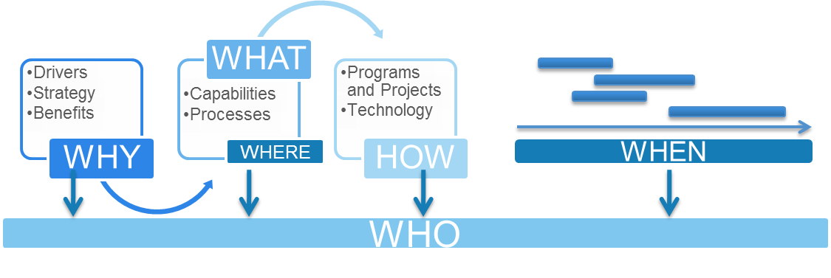
Information Driven Approach
Value Model
Drivers
Processes
Investment objective
Stakeholders
IT Service
Feature
KPI
Organization
Reference Architecture
Strategy
Location
Industry
Solution architecture
Capabilities
Scenario
Programs and projects
Business benefits
Technology
Market
Workload
Business change
Sector
Roadmap
Business Case
Infrastructure
Notes:
VRF provides the methodology to capture, analyse and structure the relevant information into a coherent and actionable plan.
A structured approach to organizing and analyzing customer data, developing a value driven program of change.

Slide 10
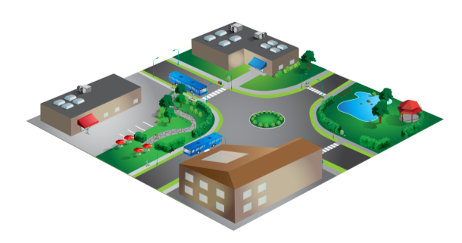
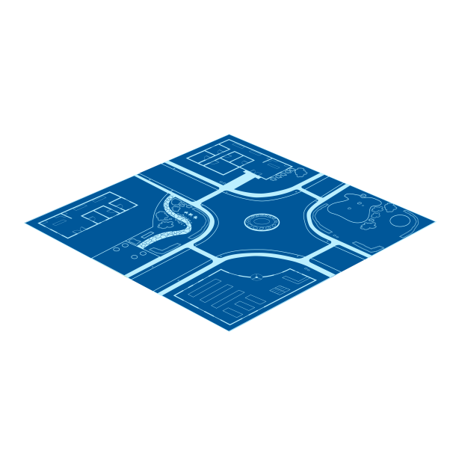
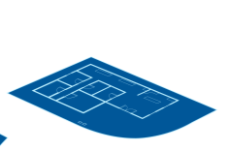
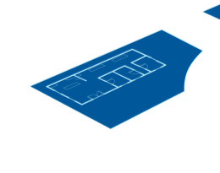
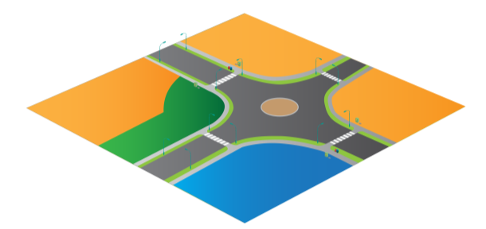
Stakeholder Perspectives
Customer
Accelerate business objectives
Business value driven IT programs
Maximize IT investments
Enterprise Architect
Evidence for opportunity identification
Proven practices
Improved time to value
Domain Experts
Extensible model for 3rd party content integration
Reduce time to develop content
Increase content utilization
Value Realization Framework
Stable framework with a focus on improvement
Enabling others to extend the platform

Slide 11

Program Scenario
The chart shows the Microsoft Enterprise Architect’s and program team activities from a typical Enterprise Strategy Program Portfolio engagement.
Enterprise Architect
Area represents relative effort expenditure over time
Cloud Value Realization
1 | 2 | 3 | 4 | 5 | 6 | 7 | 8 | 9 | 10 | 11 | 12
360 Assessment
Optimized Desktop Strategy
Acquisition 360 Assessment
Productivity Adoption Project
Cloud Strategy
EBC
Merger
Azure implementation
Desktop App-V implementation
Microsoft Services
Partner of choice

Slide 12
Prescribing the Experience
The Value Realization Framework prescribes certain activities and outcomes to ensure delivery of the value defined in the Enterprise Strategy Program.
Assessments
Completed early in the program and updated regularly to reflect business strategy and priorities.
Information Milestones
Clear definition of the information to be captured at key points in the VRF to ensure consistency and completeness.
Traceability
Change programs and roadmaps are clearly aligned with benefits analysis to ensure prioritization of actions to maximize investments.
Value Driven Program of Change
The programmatic delivery of value begins with assessments of opportunities and progresses all the way through to ensuring effective adoption.
Notes:
Notes:
There are many potential assessments – but a defined core must be completed early in the engagement and then reviewed regularly to determine the additional assessments required.
Information based milestones rather than process based milestones to recognize the variations in permitted process but the fundamental gating that requires all the information to be complete before progressing.
A value driven program of change reflects the underlying interrogative model and our ability to link all the way from business driver through to individual technology feature and deployment date and explain the value of doing the work.
Whole lifecycle makes a key point that our work does not end with the strategy but progresses through deployment and to adoption.

Slide 13
VRF Differentiation
The Value Realization Framework differs from many of the other frameworks and methodologies used in this business through the use of structured data, analytical models and clear methods to provide measurable value in clear business terms for IT investments.
Value
Prediction
Extrapolation from incomplete information
Accurate diagnosis
Value Driven Program of Change
Reduce time to value
Improved success rate
Value
Realization
Success is based on business KPIs
Data provides feedback into value prediction

Slide 14
Value Realization Framework
Architecture – Level 2
Notes:
This is the first breakdown of the VRF architecture following the initial introduction to the VRF architecture and it’s purpose. Additional breakdowns continue through the

Slide 15
Overview
This presentation drills into the first layer of the architecture of VRF to explain the key concepts, define the core information model, key representations and high level processes.
Strata
Describes the architecture at a high level from a number of different viewpoints to provide context to understand why VRF is structured as it is.
Visualization, Diagrams and Models
A small set of visualizations, diagrams and models are used consistently throughout VRF to document business and IT analysis and provide traceability.
Information architecture
Information is core to VRF. This section looks at the high level information model behind the core visualizations, diagrams and models.
Phases and Activities
For each segment and phase this describes the generic process between the information milestones and the specification for contractual deliverables and SME generated content.

Slide 16
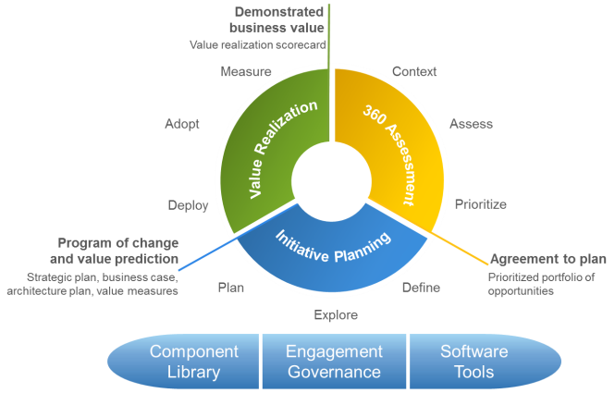
Naming Conventions
VRF Segment
The 3 major types of work performed in an Enterprise Strategy Program
Phase
Phases are subdivided into Activities which are then broken down into Tasks
Desired outcome
The end of a segment provides the information necessary to make an informed decision
Deliverables
Prescribed deliverables at key information milestones
Information Milestone
Typically only defined for the end of a segment or phase.
VRF Enablers

Slide 17
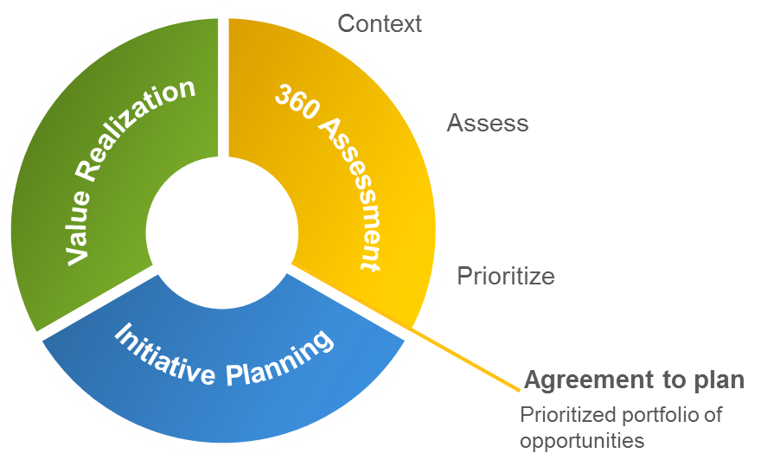
Key Concepts for Content Creators
Business
Organization
IT
Microsoft
Notes:
.

Slide 18
Key Concepts for Content Creators
Business
What information do you need to do a high quality assessment?
Organization
IT
Microsoft
Data Collection
What is the structure of the data you are collecting?
Models
What questions do you want answered?
Analysis
What opportunity patterns do our platforms address?
Opportunities
Now package this for VRF.
Notes:
.

Slide 19
Positioning VRF
Value Realization Framework
Includes component library (MAPF)
Strategic
Planning
SDM and MOF
Scope
Program
Project
Strategy
Envision
Plan
Build
Stabilize
Deploy
Adopt
Lifecycle phase
Notes:
This is a VERY simplified diagram to help position the different Microsoft methodologies.

Slide 20
VRF 1.0 Jan 2011
360 Assessment
Initiative Planning
Value Realization
Component
Library
Engagement
Governance
Software
Tools
Context
Assess
Prioritize
Define
Explore
Plan
Deploy
Adopt
Measure
Based on refactored EAVR adding the ability to ‘plug-in’ new assessments and leverage Point-of-View content in the Assess phase.
BITSB content leveraged for the Context phase.
Based on a refactored Strategy and Planning Foundation.
Value Realization services delivered primarily through BSC projects.
MAPF adopted as VRF Component Library
VRF data model defined
Standard Engagement Governance approach refactored from EAVR and S&P.
Notes:
The VRF is an evolution of what has been used before, re-worked to align with the focus on solving customer’s biggest business problems, aligning their EA with their business objectives, and maximizing the value of their IT. This moves away from ITAP’s more technical approach of minimizing the risk of achieving IT results through architecture expertise and experience. The architecture described here is for the v1.0 release of VRF to be released in Jan 2011. Additional detail for the V1.5 release will be created in Dec 2010.
The following statements are summaries from the Enterprise Strategy Program FY11 Plan v4.1 and other FY11 documents to provide a baseline to understand the aspirations for VRF.
The Enterprise Strategy program engagement is the flagship service offered by the Enterprise Strategy business and delivered by Enterprise Architects. This service ensures customers realize the maximum possible value from Microsoft in the cloud and on premises, through a proven step-by-step approach to transforming business through technology, aligning Microsoft software and services with business objectives, and optimizing IT investment for maximum value. The program is complimentary to ITAP services, which minimize the risk of achieving desired IT results through architecture expertise and experience.
We must create for our customers a differentiated experience where we use a step-by-step approach to iteratively optimize performance, delivering predictable outcomes and results with industry benchmarking and tailoring to unique customer needs and opportunities. Looking at content, while ITAP focuses mainly on solution envisioning, planning, and architecture, the Enterprise Strategy services start with a 360⁰ architecture assessment of a customer’s business priorities and IT environment. This assessment identifies and prioritizes opportunities based on business value and timeliness, and develops architecture strategies and plans to realize these through a “Catalog” of services for deeper engagement in specific areas. We also own ensuring the Enterprise Strategy program delivers this broad service catalog focused on strategy and planning for scenarios (Journey to the Cloud, Optimized Desktop, Productivity, Mission Critical Platform, Business Intelligence, and Business Ready Security) and specialist services (Business Adoption, Value Realization, Enterprise Architecture, Governance) that require official accredited resources to deliver. The content of the program must include a structured program of invitation-only strategic briefings, workshops, and customer connection programs that provides industry insights and benchmarks and a channel for organizations like MSIT and the BGs to directly engage with customers on their needs and opportunities.
We will build our proprietary methodology through a Value Realization Framework (VRF) that delivers a proven, flexible, step-by-step approach to create a blueprint for performance improvements, which is optimized to each customer’s unique needs and opportunities accommodating industry context, and benchmarked against best practice. This is a shift away from ITAP where a mix of delivery methodologies are used around the world. The VRF uses the new Enterprise Strategy Library to provide reference enterprise architectures, industry blueprints, heterogeneous interoperability approaches, and examples that can be leveraged immediately around the world. The Library includes collaborative tools and an Expert Desk providing a back office service that is staffed by business analysts in India, specifically headhunted to support the Enterprise Architects on their engagements.
Achieving the aspiration described above is a significant undertaking, v1.0 is the first of a number of releases over the next 18 months to realize this vision.

Slide 21
Historical Context
FY09
FY10
FY11
Business and IT Strategy Briefing
Nov 2008
Enterprise Strategy Portfolio
Value Realization Framework
Platform Rationalization
July 2007
Advisory Services Program
July 2009
Enterprise Agreement Value Realization
360
Assessment
Strategy and Planning for SOA Services Delivery
Dec 2008
Strategy and Planning For Optimized Desktop
Initiatives Planning
Architecture Transformation
June 2007
Strategy and Planning for S+S
May 2009
Value
Realization
Strategy and Planning For Business Ready Security
MSF EA
2004
Engagement Governance
Strategy and Planning Foundation
June 2009
MTSS
Mar 2005
Strategy and Planning For Journey to the Cloud
Engagement Delivery Framework
June 2008
Enterprise Strategy Library
Microsoft Architecture and Planning Framework
October 2009
Enterprise Strategy Network
Sample Deliverables Library
Dec 2009
Notes:
This diagram provides a retrospective view of the content created in the last 3 years for the ITAP practice to the new releases for Enterprise Strategy practice at the start of FY11. This material ranges from delivery guides, templates, worked examples to field contributions from actual engagements, in total over 2.4GB in 1,600 files. It’s worth noting that the story starts much earlier with materials called MTSS. All of the

Slide 22
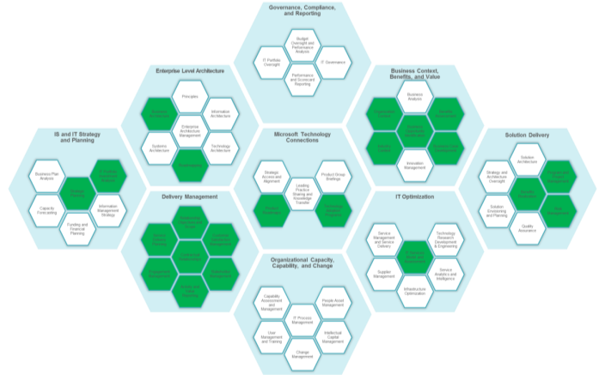
Component Library | Overview
Microsoft Architecture and Planning Framework
MAPF has been adopted as the Component Library in VRF.
Future component updates will be driven by requirements defined for the VRF scope.
Component descriptions, templates and guidance will be enhanced to include detailed information for interface descriptions to align with the VRF Information Model.
Notes:
In July 2009 the Microsoft Architecture and Planning Framework or MAPF was conceived to provide a structure to categorize and organize the many techniques used in Enterprise Strategy engagements. Twenty three of these components, shown in green on the MAPF diagram here have been updated with new methods and templates. These are shared components, core to the work performed in the EAVR phase and the Strategy and Planning projects.

Slide 23
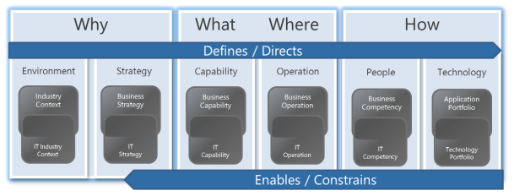
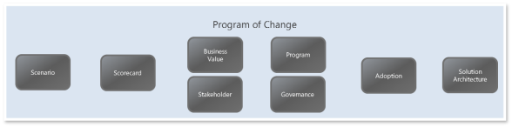
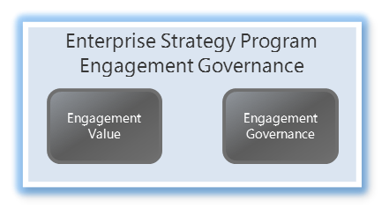
VRF Information Models
Enables value delivery through an Information-centric program of change
Business State Models Identify the current state and future state of the business and IT environment, strategy, capability, operations, people and technology. The gap between the current state and desired future state defines the program of change.
Business Change Models
Define the program of change described in the strategy, including business drivers, capability changes, operational changes, competency changes and technology changes and the corresponding desired benefits.
ESP Engagement Governance Models
Manage the activities performed by ES&A resources through the lifecycle of the engagement and measures the value delivered by the program.

Slide 24
Application Portfolio
Describes the collection of applications that support the business
Technology
The Application Portfolio describe the applications, application components, and logical features that exist within an enterprise that support specific business processes or activities. The Application Portfolio Model defines the entities (and their attributes) and relationships between entities that are needed to addresses the concerns of the business executives, managers and users regarding the current state and future state of applications that exist within the environment. The Technology Portfolio is linked to the Application Portfolio model via the relationship between logical and physical features.
Application Portfolio
Technology
Portfolio
Business Capability
Business Service
Process/ Activity
Task
Competency
Application
Portfolio
Application
Application Component
Logical Feature
Application User
IT Capability
IT Service
Workload
Physical Feature

Slide 25
Technology Portfolio
Describes the collection of applications that support the business
Technology
The Technology Portfolio describe the physical application components, IT platforms and IT infrastructures that exist within an enterprise. The Technology Portfolio Model defines the entities (and their attributes) and relationships that are needed to addresses the concerns of the IT executives, managers and developers and operators regarding the current state and future state of information technology assets that exist within the environment. The Technology Portfolio Model is linked to the Application Portfolio Model via the relationship between logical and physical features.
Application Portfolio
Technology
Portfolio
Application
Application Component
Logical Feature
Application User
Technology
Portfolio
IT Capability
IT Service
Workload
Physical Feature
IT Platform
Subsystem
Product
Deployable
Component
License

Slide 26
Program
Describes the changes and sequenced set of activities needed to affect the change
Program of Change
The Program is the way in which we describe the program of change defined by the gaps identified through analysis of the current and future business state models. The Program Model defines the entities and relationships that are needed to addresses the concerns of the key stakeholders involved in the development of the solution and describes the programs, projects, tasks, key milestones, and resources.
The Program Plan Model is linked to the business state models via the business state change entities.
Program
Program
Strategy Change
Capability Change
Operational
Change
Competency Change
Benefit
Program
Project
Requirement
Technology Change
Stakeholder
Resource
Task

Slide 27
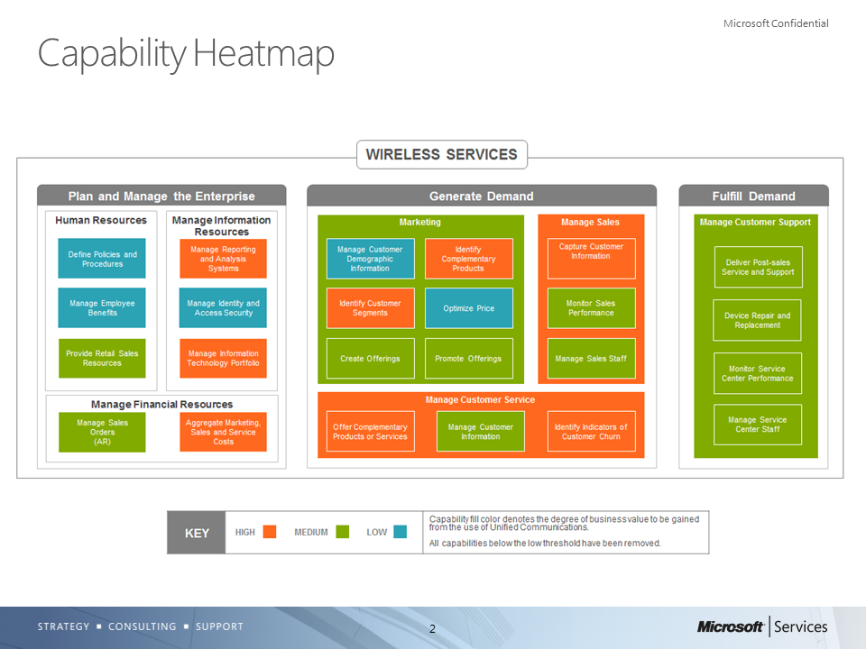
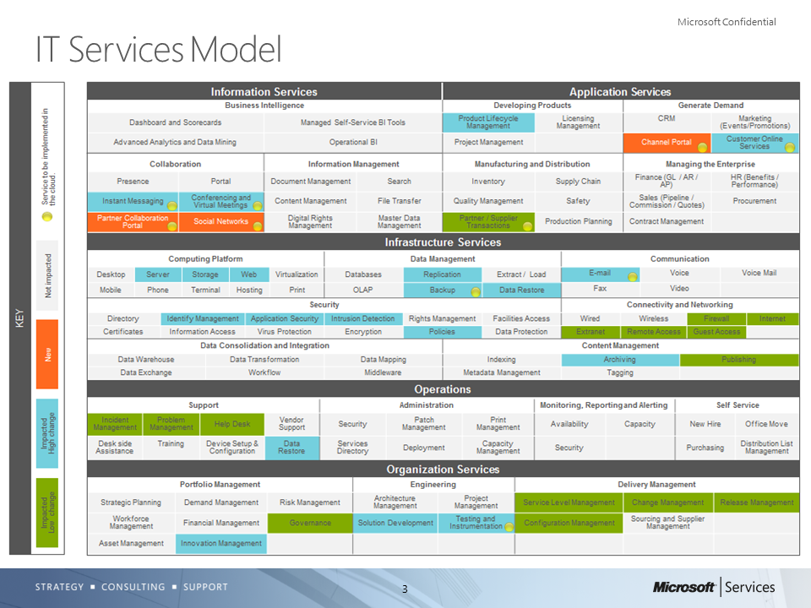
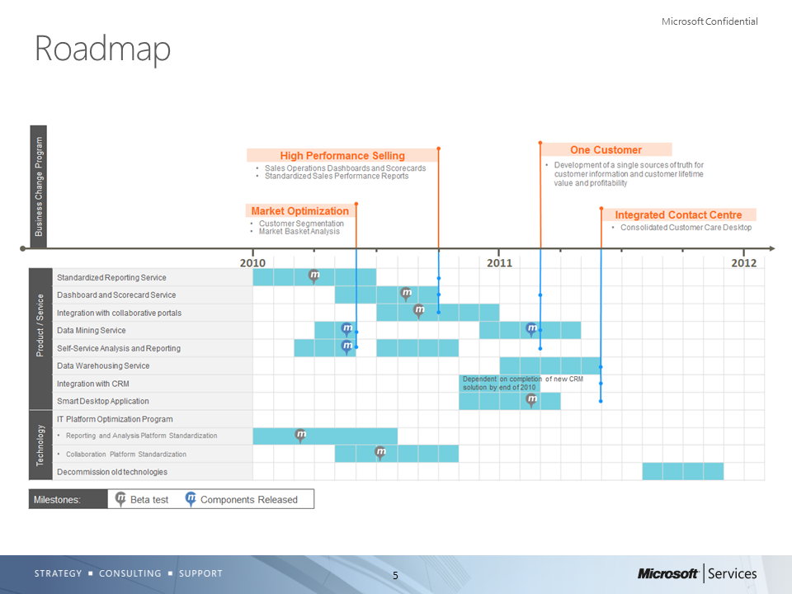
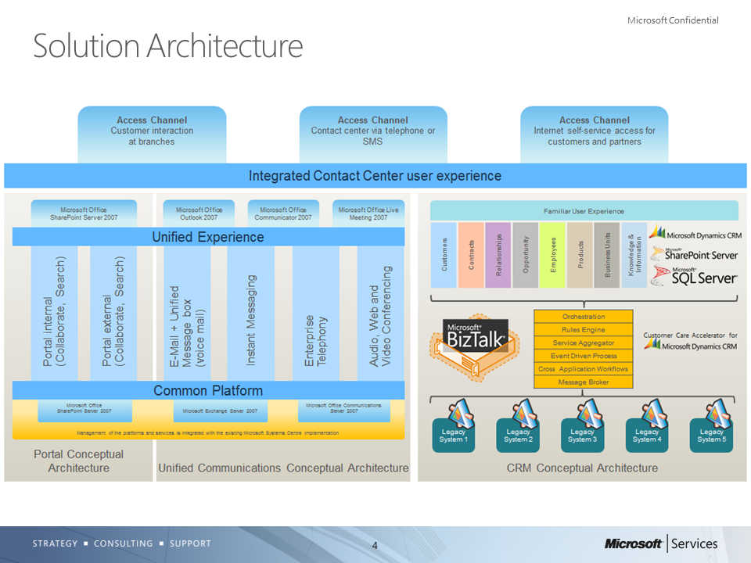
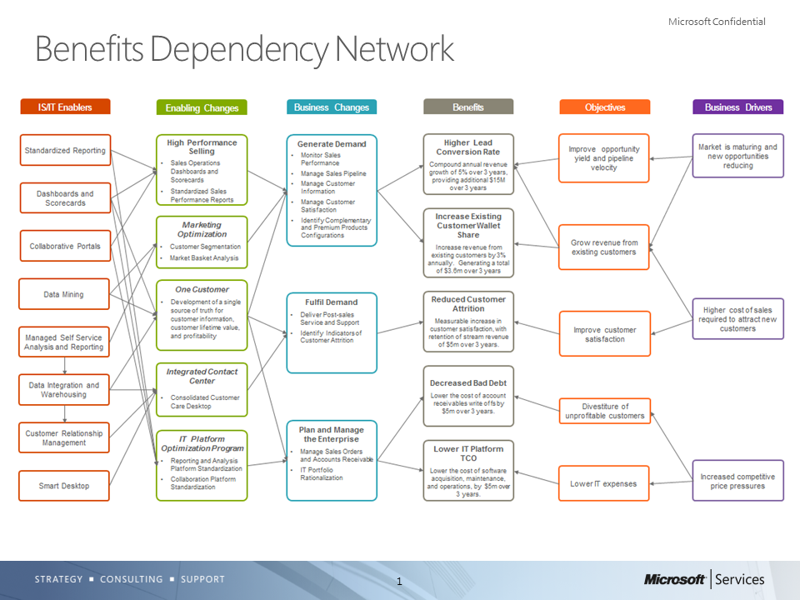
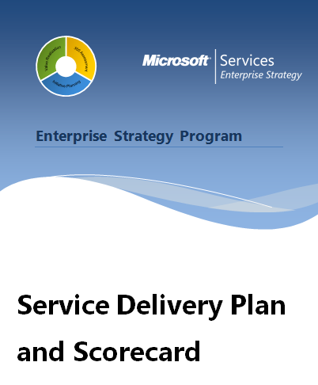
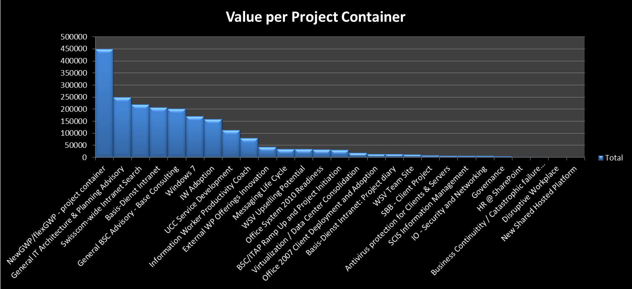




Value Delivery Cycle
Prioritization and Planning
Initiative Planning
Value Realization
Other
Initiative Planning
360 Assessment
Value Realization
Service Delivery Plan
and Scorecard
Service Delivery Plan
and Scorecard
Value Model
Internal IT
Microsoft Services
Hybrid
Partner of Choice
Governance and Oversight

Slide 28

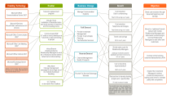
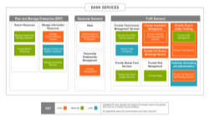
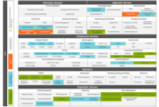
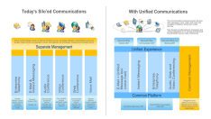
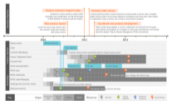
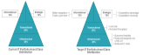
Visualization, Diagrams and Models
Models for communication
VRF has an Information Model at its foundation. This information model is represented to customers through visualizations, diagrams and graphical models. These form the basis for succinct and clear communications in presentations and documents.
A small number of models are considered core to VRF. The use and structure of these models is prescribed to ensure a consistent representation for analysis, imagery and branding for VRF deliverables. Other models may be used within VRF to support other parts of the analysis. For these the visualizations and diagrams may draw from many sources.
Core to VRF
VRF 1.0 identifies a set of core models, additional models will be included in future releases.

Slide 29

Model: Portfolio Assessment
IS & IT Strategy and Planning | IT Portfolio Investment Analysis
Purpose
Example
These models provide a framework to analyze and categorize investments in the overall IT Portfolio. This can be used to align IT spend with business goals, and compare the contributions of different applications to the business and against a broader industry data set.
Core data
Why
What Where
How
Core data
People
Technology
Environment
Strategy
Capability
Operation
Industry
Context
Business
Strategy
Business
Capability
Business
Operation
Business
Competency
Application
Portfolio
IT Industry
Context
IT Strategy
IT
Capability
IT
Operation
IT
Competency
Technology
Portfolio
Program of Change
Business Value
Program
Scenario
Scorecard
Adoption
Solution Architecture
Stakeholder
Governance
Notes:
The Application Portfolio Matrix is a very powerful, benefits-oriented, technique for successfully describing IT plans. This describes the investments in applications and services (deployed, planned, and future opportunities), not in terms of the technology or sourcing options, but in terms of their contribution to the business.
Most organisations currently use an informal approach to the process of managing the portfolio of projects to be selected for implementation. The selection process through which an idea must pass, before it eventually becomes a project being implemented, are often those of feasibility and practicality within the available budget available to the project sponsor.
This process has two weaknesses:
it is hard to justify architectural platforms where payback is dependent on a group of one, or more, additional applications that leverage the platform;
it assumes that there is capacity to deliver all the projects considered viable.
Mapping applications to this matrix is the first step in a balanced discussion about the range of applications in the portfolio. Since the nature of the benefits is different in each of the quadrants, the manner in which the applications will be built, and managed, also differs. Delivering the benefits for a Strategic application, which will involve fundamental new ways of working, requires a different approach than driving down costs in a Support application.
MIT CISR has been collecting information since 1994 on the mix of IT portfolios to help organizations compare with their own portfolio mix. Typically IT portfolios are used by executives to analyse the IT spend and assess strategic fit. Each asset class has its own risk/return profile and contribution to the overall effectiveness and growth of the organization.
The IT portfolio includes all spending on IT in the organization. This is categorized into four different management objectives for IT investments:
Transactional – to reduce costs or increase throughput by using IT to automate repetitive workloads.
Informational – to provide information to support activities such as reporting, management, control, compliance or analysis.
Strategic – to gain a competitive advantage or improved market position.
Infrastructure – to provide the IT services (databases, servers, networks, hardware, software, but not applications) that are a foundation for the organization’s shared use of IT.
Once an overall balance has been agreed the specific project portfolio in each asset class can be prioritized. Other components of the Microsoft® Architecture and Planning Framework provide the methods to prioritize projects within each asset class and provide governance of the portfolio to ensure implementation aligns with intent.

Slide 30
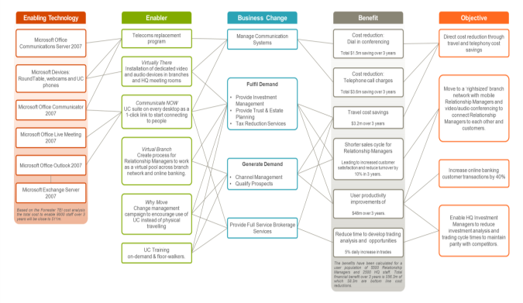
Model: Benefits Dependency Network
Business Context, Benefits and Value | Benefits Assessment
Purpose
Example
The Benefits Dependency Network (BDN) derives from a benefits management approach. Its usage has evolved in Microsoft Services to provide a structure to define the traceability from business strategy to IT implementation.
Core data
Why
What Where
How
Core data
People
Technology
Environment
Strategy
Capability
Operation
Industry
Context
Business
Strategy
Business
Capability
Business
Operation
Business
Competency
Application
Portfolio
All of the core models should be considered simple representations to aid communication of more complicated data set that requires supporting documentation. The BDN is a good example of this, where a one page diagram can describe significant business transformation, but to be fully understood requires detailed documentary support and evidence in customer deliverables to explain the simplified content in the BDN columns.
IT Industry
Context
IT Strategy
IT
Capability
IT
Operation
IT
Competency
Technology
Portfolio
Program of Change
Business Value
Program
Scenario
Scorecard
Adoption
Solution Architecture
Stakeholder
Governance
Notes:
Creating a BDN starts with an understanding of why the business wants to change, by capturing the drivers, objectives, and benefits. It then connects the benefits to the business activities, to understand what will have to change to realize the benefits. We also gain a better understanding of where the changes will happen in the organization units, and specific locations.
We determine how to make the changes through projects that will change business activities, and implement the technologies that will support them. In all of this, we can also identify the stakeholders who will be responsible for demonstrating that the benefits are achieved, who own the business activities, and who will run the projects.
By prioritizing the objectives and benefits, and then incorporating resource constraints and technology dependencies, we can use this model to sequence the projects and show when they will be implemented on a time line or roadmap.
The BDN draws on an analysis of the organization’s business objectives and drivers, and feeds into the creation of business cases and roadmaps, stakeholder management plans and long term benefit management plans.

Slide 31
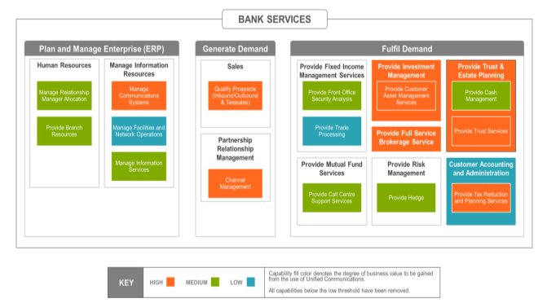
Model: Business Capability Model & Heatmap
Enterprise Level Architecture | Business Architecture
Purpose
Example
Business Capability Models derive from Microsoft Services Business Architecture (MSBA), a unique approach developed by Microsoft to define a business architecture using the concept of business capabilities. With 11 patents pending MSBA has helped many organizations identify and manage change.
Core data
Why
What Where
How
Core data
People
Technology
Environment
Strategy
Capability
Operation
A capability is an abstract view of the functions of a business. The capability data set varies with industry and will take input from the ES&A Industry Team.
Capabilities are measurable and have a range of properties. Definitions for common properties will be defined in the VRF Information Model.
The required route for the capture of capability data and creation of heatmap visualizations is through the ES&A supported toolset.
Industry
Context
Business
Strategy
Business
Capability
Business
Operation
Business
Competency
Application
Portfolio
IT Industry
Context
IT Strategy
IT
Capability
IT
Operation
IT
Competency
Technology
Portfolio
Program of Change
Business Value
Program
Scenario
Scorecard
Adoption
Solution Architecture
Stakeholder
Governance
Notes:
The use of capabilities provides an abstract view of the organization that remains stable, even as processes, technologies, and people change.
Even the changes that are associated with outsourcing do not change the capability map.
The capability map acts as a common language that can be used between both the business and IT. Having studied businesses across many industries, Microsoft identified a common model that allow for a rapid analysis and understanding of an organization.
For each capability we capture property information to help understand where to focus. There are a few properties that are often included for project-scoping work:
• Business value: The strategic value of a capability or the degree to which it affects organizational performance. This is the measure to which a capability is a market differentiator or a competitive requirement.
• Maturity: The level of consistency and predictability with which the capability is performed. Is there a well-defined process in place that is monitored and measured?
• Performance: To understand the service-level expectations and how the capability currently achieves them.

Slide 32
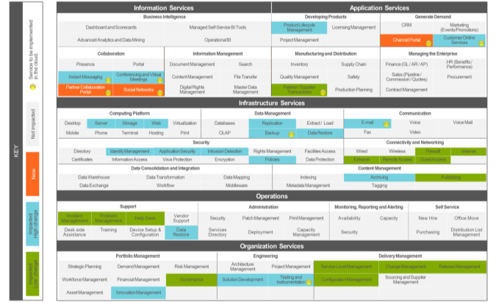
Model: IT Services Model
IT Optimization | IT Services Model and Assessment
Purpose
Example
With a Microsoft patent pending the IT Services Model has helped many organizations understand the changing requirements for IT as a portfolio of services that supports the business.
Core data
Why
What Where
How
Core data
People
Technology
Environment
Strategy
Capability
Operation
Industry
Context
Business
Strategy
Business
Capability
Business
Operation
Business
Competency
Application
Portfolio
The generic IT Services data set will be maintained by the ES&A Architects Team.
IT Services are measurable and have a range of properties. Definitions for common properties will be defined in the VRF Information Model.
The required route for the capture of capability data and creation of heatmap visualizations is through the ES&A supported toolset.
IT Industry
Context
IT Strategy
IT
Capability
IT
Operation
IT
Competency
Technology
Portfolio
Program of Change
Business Value
Program
Scenario
Scorecard
Adoption
Solution Architecture
Stakeholder
Governance
Notes:
A service is a set of related functions IT performs, or provides, that is seen as a coherent, self-contained, manageable entity. The services provide the necessary capabilities to the organization to perform business activities.
Over time the services provided by IT change as new technologies and operating models evolve. Some services may be focused on business processes, others on the internals of IT itself. Some may be targeted at discrete business communities, some as shared services for multiple groups, and some as utilities for everyone.
The IT Services Model is used in a number of ways to visually represent current state, future state, and impact of potential projects. The Cloud computing opportunities identified in this example will have an impact on the SLAs, people skills, and even potentially moving the operation of the service out of the internal IT organization.
The services that are directly focused on business users are viewed as external or business-facing services. The business-facing services are the products that IT provides, much like what a company provides to its customers. These services typically represent the transformation of technologies (hardware and software) into business capabilities.
Like any other organization, certain services are internal to the IT organization. These services are performed to support other internal or business-facing services; for example, database administration, change management, and project management.
Services are categorized firstly into domains, then clusters, which are grouped together based on the close affinity to other related capabilities, or functions they provide. The clusters are useful for assigning service owners, and mapping organizational structure to services
Whilst domains are relatively stable across organizations the cluster and services vary for each customer, depending on the scope and maturity of the IT organization, and the nature of the business.
Infrastructure services are the foundation and building blocks for other services. Typically, an infrastructure service exists because many application services require it, and it is therefore provided “in common”.
Application and Information services are those services which the user community would typically recognize, because they directly support the business. Because businesses vary widely, and industries vary even more widely, it will be in the application and Information service areas that there is the greatest variation in services.
Organization services exist because other services exist. For example, there are usually on-going projects and initiatives, therefore the organization needs to manage these projects.
Operations services exist because infrastructure, information and applications services need to be maintained and operated.

Slide 33
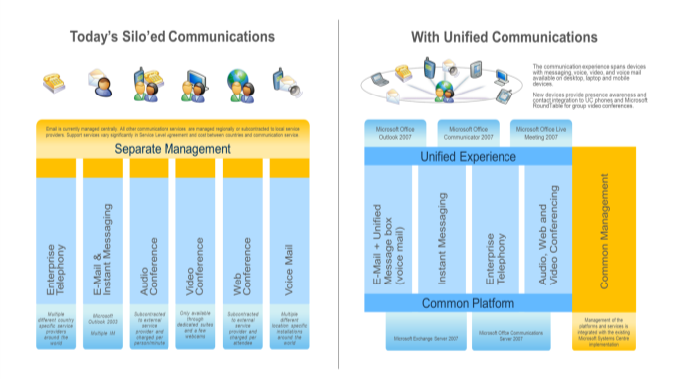
Model: Conceptual Architecture
Solution Delivery | Solution Architecture
Purpose
Example
Conceptual architecture models help to understand the problem domain and in many cases decompose it into simpler domains and the relationships between them.
Core data
Why
What Where
How
Core data
People
Technology
Environment
Strategy
Capability
Operation
There is no standard for a conceptual architecture model. It is considered a core diagram in VRF on the basis that this level of representation is designed for the ‘C’ level audience as a starting point to decompose technical solutions.
A conceptual architecture is considered a key requirement from a subject-matter reference model and a contributor to key customer deliverables.
Industry
Context
Business
Strategy
Business
Capability
Business
Operation
Business
Competency
Application
Portfolio
IT Industry
Context
IT Strategy
IT
Capability
IT
Operation
IT
Competency
Technology
Portfolio
Program of Change
Business Value
Program
Scenario
Scorecard
Adoption
Solution Architecture
Stakeholder
Governance
Notes:
The creation of a conceptual model is a first step in developing more detailed quantitative models for a solution architecture. It is advantageous to create a conceptual architecture model when attempting to understand a complex problem or introducing a new concept:
to provide a frame of reference to position the subject with respect to what is already understood;
and to act as a framework to structure the development of more detail.
Architecture models are often classified as conceptual, logical, and physical views.
Conceptual views are the most abstract and tend to be described in terms that are most familiar to the non-IT professional. The conceptual view is used to define the scope and the problem domain.
Logical views show the main functional components and their relationships within a system independently of the technical details of how the functionality is implemented.
Physical views are the least abstract and illustrate the specific implementation components and their relationships.
ITAP tends to focus on the Conceptual views, and sometimes on logical views. Physical views are normally created as a part of a deeper technical architecture.
The primary requirement for a conceptual architecture model is to be an effective communication tool. The audience is typically non-IT professionals who need to understand the scope and key concepts for them to support the initiative being proposed.
Whilst there are standards and expectations for the logical and physical models the conceptual model is much more variable and contains whatever information necessary to be an effective communication mechanism.

Slide 34

Model: Roadmap
Enterprise Level Architecture | Roadmapping
Purpose
Example
Architects use road maps to describe the transition from the customer's current state to their desired future state for technology planning and synchronizing business planning with technology strategy. In the format defined for VRF the roadmap also clearly shows the relationship between business objectives, new services and technologies.
Replace text with an image of the model
Core data
Why
What Where
How
Core data
People
Technology
Environment
Strategy
Capability
Operation
With multiple stakeholders, who have different perspectives, it is not uncommon to have different versions of a roadmap with different levels of detail to simplify the communications for the different stakeholder groups. In all cases a roadmap should :
have a defined scope, and goal;
identify the sequence of activities and events to reach that goal;
Identify clear decision points to control progress;
be based on a timeline to illustrate the rate of change.
Industry
Context
Business
Strategy
Business
Capability
Business
Operation
Business
Competency
Application
Portfolio
IT Industry
Context
IT Strategy
IT
Capability
IT
Operation
IT
Competency
Technology
Portfolio
Program of Change
Business Value
Program
Scenario
Scorecard
Adoption
Solution Architecture
Stakeholder
Governance
Notes:
Roadmaps can take many forms, but the most common approach is a time-based chart, with a number of layers that typically include both business, and technological perspectives. Common applications of a roadmap include Product Planning, IT Strategy, Architecture Development, Infrastructure Services, and Business Initiatives.
A roadmap is created after the definition of the strategies, objectives and programs has been performed. The roadmap then is a communication tool to show the gap analysis and change-management problem.
Roadmaps include information drawn from many sources:
Business capability needs
Capabilities and requirements for the business’s desired end state.
IT capability needs
Capabilities and requirements for the IT department’s desired end state.
Current state of services
An inventory and evaluation of the current services architecture for the current state
Current state of technology
An inventory and evaluation of the current technologies and architectures for the current state.
Current project plans
A current list of planned projects and initiatives for the IT department.
Financials
An understanding of budget, prioritization process, and other related financial processes for establishing and managing IT projects.
Microsoft product plans
The release and support roadmap for the Microsoft products, and technologies that the customer is using, owns, and could use.
IT governance
An understanding of overall IT governance, and organizational structure for the company.

Slide 35
Value Realization Framework
Architecture – Level 2 - Process
Notes:
This is the first breakdown of the VRF architecture following the initial introduction to the VRF architecture and it’s purpose. Additional breakdowns continue through the

Slide 36
VRF Segments, Phases & Enablers
Demonstrated
business value
Value realization scorecard
Measure
Context
Value Realization
Initiative Planning
Adopt
360 Assessment
Assess
Deploy
Prioritize
Program of change
and value prediction
Agreement to plan
Strategic plan, business case, architecture plan, value measures
Plan
Define
Prioritized portfolio of opportunities
Explore
Component Library
Engagement Governance
Software
Tools
Notes:
360 Assessment: The process and information captured evolves from BITSB, an IT Strategy Briefing that’s been around for over two years. Enterprise Agreement Value Realization (EAVR) was released in June which was built on work being developed around the world the past two years. It has three phases: context, possess, and prioritize.
Context: Identify the top level drivers for a customer’s business, what’s pushing them in their particular market place, understand their current IT Portfolio, capture what they’re working on, what their IT organization looks like, and get an idea of what’s in their Enterprise Agreement. For example, what software they’ve bought, what Microsoft services they have. We’re not going to describe how long this takes. It could take you four or five hours. If a customer is really organized, you may have a quick answer. Or, it could take you two or three weeks with a customer that has information all over the place. But at the end, you’ve worked out the assessments.
Assess: For example, you know the customer is interested in Cloud and getting their desktop optimized and maybe six or seven other areas. That gives us a program of work around doing some assessments. The assessments drill in more deeply to each of those areas to find opportunities and help them realize value, reduce cost, risk, time to market and many different areas of potential benefit. At a high level, we have a set of opportunities. Within the work behind the VRF we have an information model that describes the opportunities in a clear data structure. Templates are available to present back to the customer, but you may have your own way or the customer may have their own tool, but the critical thing for us to have is a point in time to say “at this point, you have this data”. When you have that, it’s your gate to move to the next step.
Prioritize: When you bring all the data from the different assessments together, prioritize which ones to work on first.
Initiative Planning: Revolves around the Strategy and Planning foundation. In FY10, it evolved to include Opportunity Cards to give the customer baseline data with which to start. The phases “Define, Explore, and Plan” are the same. The names and overall structure aren’t changing, but it’s refocused around the information that needs to be created. At the end of Initiative Planning, you have a strategic plan to give the customer an understanding of why they are taking this particular route of choices, a financial case, a value prediction model, and an architectural plan with a roadmap.
Value Realization
Deploy: you don’t actually do deployment. You are not the program manager. But you oversee deployment and help the customer if they have issues.
Adopt: You help the customer through the change process.
Measure: Records the value being delivered and the result of the engagement.
Component Library – MAPF is a library of repeatable components and each component consists of a method and templates.
Engagement Governance – it’s critical when done well and consistently. It includes conditions of satisfaction, team meetings, status reports, etc. Ensure that it aligns with (Software Development Framework) SDF.
Software Tools – if we are able to get to the data to work with the customer and define the data appropriately, we can build tools on that dataset to automate the capture of the data, create the visual representations, and behind the scenes, to aggregate data to predict value.

Slide 37
VRF Information Milestones
Demonstrated
business value
Value realization scorecard
Measure
Context
Assessment Plan
Value Realization
Initiative Planning
Adopt
360 Assessment
Assess
Identified Opportunities
Deploy
Prioritize
Program of change
and value prediction
Agreement to plan
Recommendations
Plan
Define
Prioritized portfolio of initiatives
Strategic plan, business case, architecture plan, value measures
Explore
Detailed scope and objectives
Draft strategic plan and initiative requirements
Notes:
360 Assessment: The process and information captured evolves from BITSB, an IT Strategy Briefing that’s been around for over two years. Enterprise Agreement Value Realization (EAVR) was released in June which was built on work being developed around the world the past two years. It has three phases: context, possess, and prioritize.
Context: Identify the top level drivers for a customer’s business, what’s pushing them in their particular market place, understand their current IT Portfolio, capture what they’re working on, what their IT organization looks like, and get an idea of what’s in their Enterprise Agreement. For example, what software they’ve bought, what Microsoft services they have. We’re not going to describe how long this takes. It could take you four or five hours. If a customer is really organized, you may have a quick answer. Or, it could take you two or three weeks with a customer that has information all over the place. But at the end, you’ve worked out the assessments.
Assess: For example, you know the customer is interested in Cloud and getting their desktop optimized and maybe six or seven other areas. That gives us a program of work around doing some assessments. The assessments drill in more deeply to each of those areas to find opportunities and help them realize value, reduce cost, risk, time to market and many different areas of potential benefit. At a high level, we have a set of opportunities. Within the work behind the VRF we have an information model that describes the opportunities in a clear data structure. Templates are available to present back to the customer, but you may have your own way or the customer may have their own tool, but the critical thing for us to have is a point in time to say “at this point, you have this data”. When you have that, it’s your gate to move to the next step.
Prioritize: When you bring all the data from the different assessments together, prioritize which ones to work on first.
Initiative Planning: Revolves around the Strategy and Planning foundation. In FY10, it evolved to include Opportunity Cards to give the customer baseline data with which to start. The phases “Define, Explore, and Plan” are the same. The names and overall structure aren’t changing, but it’s refocused around the information that needs to be created. At the end of Initiative Planning, you have a strategic plan to give the customer an understanding of why they are taking this particular route of choices, a financial case, a value prediction model, and an architectural plan with a roadmap.
Value Realization
Deploy: you don’t actually do deployment. You are not the program manager. But you oversee deployment and help the customer if they have issues.
Adopt: You help the customer through the change process.
Measure: Records the value being delivered and the result of the engagement.
Component Library – MAPF is a library of repeatable components and each component consists of a method and templates.
Engagement Governance – it’s critical when done well and consistently. It includes conditions of satisfaction, team meetings, status reports, etc. Ensure that it aligns with (Software Development Framework) SDF.
Software Tools – if we are able to get to the data to work with the customer and define the data appropriately, we can build tools on that dataset to automate the capture of the data, create the visual representations, and behind the scenes, to aggregate data to predict value.

Slide 38
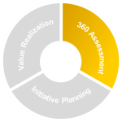
Segment Overview
In the first phase the Enterprise Architect gathers core data on the customers:
IT Portfolio; Organization and Stakeholders; Business Strategy, Industry and Market position; and Microsoft license and service contracts.
A list of potential assessments are reviewed with the customer to identify those to perform and a timeline for completion.
Assessments are ‘pluggable’, all with the same output, a set of defined opportunities to a core data definition of an opportunity.
The output from all assessments to date are integrated and prioritized to determine the ESP roadmap. These are recorded in the Service Delivery Plan with a Scorecard definition.
Context
Customer Insights
Understand Customer Strategies and Priorities
Select and Plan Assessments
360 Assessment
Assess
Assess Current State
Define Future State
Opportunity Identification
Prioritize
Select and Optimize Opportunities
Sequence Initiatives
Update Scorecard
Notes:
In this first segment of VRF a list of strategic IT initiatives is defined that align with business goals, along with potential ROI. The key objective of the assessment is to evaluate the customer’s business goals and priorities and arm the customer with the right information to make an informed decision on which initiatives to prioritize for further planning/investigation.
In addition to developing assessments from the customer’s information this is also an opportunity to present to the customer a Microsoft Point-of-View on key stories aligned with EPG direction. After the completion of the 360 Assessment, the customer may select projects within the Initiative Planning or Value Realization segments, primarily drawn from the Service Offering catalog.

Slide 39
Segment Outcome
The base engagement data is maintained throughout the life of the engagement as a known starting point for all further project work.
Assessments can be added or updated throughout the life of the engagement with the agreement of the customer. Updating the SDP as appropriate.
VRF core models are used in the assessment outputs to provide a high level business, IT and benefit structure, and to visualize the impact of the portfolio of projects.
The SDP Roadmap and Scorecard is reviewed with the customer in regular engagement governance meetings where an action may be taken to re-prioritize and plan as new opportunities are identified.
Context
Base engagement data captured
Assessments selected and planned
360 Assessment
Assess
Shared Point of View
Future State Vision
Opportunities identified
Prioritize
Integrated and prioritized set of opportunities to progress
Roadmap and scorecard defined for the Service Delivery Plan
Notes:
ITBenefit dependency network (Drivers, Strategy, Investment Objectives, Benefits, Business Change)
Business capability map for the high potential opportunities (aligns with the BDN business changes)
Stakeholder map (beneficiaries, executive sponsor, change enabler)
IT service model for each of the high potential opportunities (aligns with business capability map)
Value prediction matrix (describes type of value that is expected and a high, low, medium rating along with an estimate on time to value; low, medium, high)
Opportunities arranged in the application portfolio matrix (key operational, high potential, strategic and support – allows a portfolio view of how the investment is being focused)
Service delivery plan for detailed investigation into the high potential opportunities

Slide 40
Segment SME Content Specification
In addition to the creation of an Assessment and associated Point of View a ‘content pack’ for 360 Assessment should also contain a Delivery Guide Supplement to summarize how to use the materials. This is in addition to the VRF Delivery Guide for this segment and does not need to repeat any of the VRF content.
An assessment should include clear instructions on how to align Microsoft Services offerings with the analysis of the assessment.
A ‘content pack’ should also provide a worked example of a completed assessment document set to define the quality standard expected.
Context
Assessment definitions for selection process
Point of View (2 page summary)
360 Assessment
Assess
Assessment tools
Point of View (presentation and white paper)
Recommendations Profile for relevant Microsoft Services offerings
Prioritize
Notes:
Detailed specifications for Point of View documents and the definition of an opportunity to be produced by an assessment will be provided in the Level 3 architecture materials.
An assessment can assume any of the contextual data has been captured but should explicitly specify the data to be used in the assessment. It may follow the PoV, current-state, future-state, opportunity identification approach or provide an alternative. It may be in the form of a spreadsheet, checklist, detailed guide or software tool. The primary criteria is that it creates a set of well defined opportunities using the VRF definition for an assessment opportunity (note this is a higher level of abstraction and detail than the opportunities identified in Initiative Planning). Here the opportunities might be a recommendation to do an initiative planning project with the evidence to support the recommendation and the details to understand the costs, resourcing requirements (specialists etc), stakeholders to be involved etc.
In the 360 Assessment, and potentially also useful in the Initiative Planning work we have defined something called a “Point of View”. This is a briefing that precedes the detail in an opportunity card and provides an overview of the subject matter to be used in CxO level briefings. A Point of View (PoV) might be written by a subject matter expert for content such as Cloud, Desktop, or Security to directly support service offerings or might be written by the industry team to describe the Microsoft PoV on a particular industry.
Purpose of the PoV document
To take a customer from a marketing message to sufficient detail to enable a conversation about our position and a desire to do more with us –
Overview of the PoV
There may be 3 different versions of a PoV:
1. A whitepaper, as the one attached that sets out a clear position and can be left with the customer
2. A PPT presentation to be shown to a customer with a guidance document on how to deliver it to facilitate conversation
3. A 2 page ‘glossy’ format that summarizes key messages that can be used to raise initial awareness of the topic and lead into the presentation or a request for a copy of the whitepaper. May be used at customer facing events as a hand-out, or in the very meetings with a customer.
The aim is to have sections tightly focused, distilled into concise messages for easy & rapid consumption.
Eventually a PoV document could be elevated up to be a services wide if not MSFT wide position from Microsoft on the subject.
www.todaysenterprise.com – positions mission critical as an example, strong messages to get into a point of view – the domain experts in the Architecture Services team have the responsibility to ensure consistency and integration of the messages – from EPG to services to external publication – with respect to a PoV
PoV documents are aligned with the EPG stories and the ES&A service offerings. When used in the 360 Assessment segment of VRF the PoV document should align with any assessment in 360 that asks questions about the subject matter to identify the high level opportunities – that might recommend an Initiative Planning project, some Value Realization adoption work or oversight of activities from other service lines. The PoV is set at a higher level than individual opportunity cards but should provide introduction to the concepts that are then detailed in the opportunity cards and be consistent in the story from PoV to opportunity card.
Description of sections
Executive Summary (1 page) – textual, descriptive, pulls from the core pillars defined in marketing campaign messages.
Introduction – PoV is a vision of the future (not compete information, 1 paragraph on the key points to explain how we have arrived at the position we are in today) – then introduces the purpose of the remaining sections to look at business challenges and how IT will address those challenges.
Today's Challenges
Elaborate the current business and technology challenges.
Business Drivers – internal and external for typical customers (generalize and abstract)
Market conditions – demand pull and tech push issues
Common capabilities, process, org issues from a business internal view that are feeling the pain
Vision for the future
How to respond to the drivers
Benefit categories customer focus on (cost reduction, new market etc) and objectives commonly stated by managers.
Include case study information
The journey, the destination and the value when you get.
NOT intending to show all the inter-relationships between driver, objective and benefit that would be shown on a BDN but certainly to show the principle connectivity through text and layout.
Immediate Focus (we want to avoid calling this out as a list of next steps or as a strategy)
A discussion of the next steps – but trying to avoid a sales style discussion
Major things to focus on for the customer to start their own planning – THIS SHOULD be in the delivery guide as talking points on how to make this real.
Conclusions
A brief and eloquent statement that identifies a “sense of urgency” statement to get the CxO to initiate an action now rather than leave this on the desk for tomorrow. Goes right back to market drivers, give them pain to stop them sleeping until they respond.

Slide 41
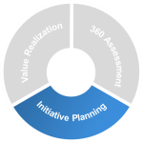
Segment Overview
The first phase is focused on the review of information from the customer and gaining approval to proceed, with a general scope for the effort. Stakeholder interviews and a Opportunity Cards are the primary path to building a robust understanding of the business challenges.
The second phase is focused on refining and understanding the real business opportunities for the customer. Using Opportunity Cards, Benefit Dependency Network workshops and Envisioning Workshops we develop a solid understanding of the business challenges.
To create a credible and actionable plan the final phase identifies the transformation and business value that Microsoft’s recommendations can create in the customer’s organization.
Define
Review Initiative Objectives and Scope
Identify Stakeholders
Gain Approval to Proceed
Initiative Planning
Explore
Assess Current State
Envision Future State
Gap Analysis
Plan
Architectural Analysis
Financial Analysis
Value Realization Planning
Recommendations
Notes:
The second part of the VRF is called Initiative Planning. This includes projects that leverage the Strategy and Planning (S&P) offerings, based on a generic process with additional subject matter–specific content in each offering. Originally an S&P offering was a project-based offering of 6 to 12 weeks duration that may be recommended as a follow-on to a Business and IT Strategy Briefing engagement, from a direct sale as the customer’s first ITAP engagement, or through the identification of an opportunity in a full-time ITAP Advisor engagement. In the Enterprise Strategy work-order these are called Enterprise Strategy Projects. Over a one year period the Enterprise Architect might execute three Enterprise Strategy Projects defined with the customer in the Services Delivery Plan. These may be focused on customer specific requirements, leveraging the standard Strategy and Planning approach or use one of a set of standard Strategy and Planning projects built to support the EPG Value Conversations and Customer Campaigns.
In July three new Strategy and Planning projects were released, for the Optimized Desktop, Business Ready Security and the Journey to the Cloud. These Enterprise Strategy projects use an updated version of the process described in the Strategy and Planning Foundation. The first part of the process is focused on the gathering of information from the customer and gaining approval to proceed, with a general scope for the effort. Stakeholder interviews and a new set of materials called Opportunity Cards are the primary path to building a robust understanding of the business challenges.
The second part of the process is focused on refining and understanding the real business opportunities for the customer. Using Opportunity Cards, Benefit Dependency Network workshops and Envisioning Workshops we develop a solid understanding of the business challenges that can be addressed with Microsoft technologies. To create a credible and actionable plan the final step completes a Strategic Plan that identifies the transformation and business value that Microsoft’s recommendations can create in the customer’s organization. This is supported with an Architecture Plan that describes the transformation in information, application and technology architectures required to implement the recommendations, with a Business Case and Value Measurement Plan that identifies how to measure and prove each anticipated customer benefit.
In the original two S&P offerings and the S&P Foundation the volume of content can look overwhelming, even before you have to understand the specific subject matter on which the offering is focused. These offerings were developed to provide an end-to-end package that could be delivered by people moving up into the role as their first major activity and came with a lot of detailed guidance. In addition to the detailed offering guidance there are also on-line training resources for the original S&P offerings that walk through a sample engagement.
The 3 new S&P offerings were developed by three different teams, working in parallel over an 8 week period, on the subject matter content. At the same time the underlying process was being streamlined with the transfer of a lot of process content into re-usable MAPF components, a consequential slimming down of the S&P content, and changes to include the Opportunity Card concept.
During FY11 the Value Realization Framework will inherit the S&P content with updates to integrate all the pieces back together into a coherent whole. Until then there is a gap between the process described in the S&P Foundation and the S&P training content and the process used in the new offerings. It is not a big gap, and for those early adopters the feedback was that the overview materials and worked examples provided with the new content illustrate the changes sufficiently that the process can be followed effectively. There will also be more updates to the S&P offerings to improve the subject matter and maintain alignment with both the EPG direction and evolution of our cloud story.

Slide 42
Segment Outcome
The primary outcome of this segment is not a set of documents, but a decision by the customer to proceed with a defined program of work, or a decision not to proceed, based on clearly presented evidence. That evidence includes:
A Strategic Plan that identifies the business value Microsoft’s recommendations can potentially create in the customer’s organization and defines the suggested implementation approach to achieve these.
An Architectural Roadmap describing the recommended information, application and technology architecture required to support the recommendations.
A Business Case with the potential benefits for each business function or component that is impacted and the related organizational changes that will enable the benefits to be realized.
A Value Realization Plan identifies the anticipated customer benefits and defines mutually agreed-upon measurement methods to demonstrate achievement of the business value.
Define
Defined objectives and scope
Initiative Planning
Explore
Draft Strategic Plan
Detailed scope and requirements
Plan
Strategic Plan
Architecture Plan
Business Case
Value Realization Plan
Notes:
These 4 output documents have been in use for 2 years now. No big changes in structure except for the new business case template that was significantly updated in Feb 2010. All have templates released in the June 2010 S&P offerings.
Considering a Business Adoption Plan for a v1.5 update

Slide 43
Segment SME Content Specification
Define
Opportunity Cards
Case Studies
Reference Model
In addition to the creation of content listed to the left a ‘content pack’ for Initiative Planning should also contain a Delivery Guide Supplement to summarize how to use the materials. This is in addition to the VRF Delivery Guide for this segment and does not need to repeat any of the VRF content.
In addition to providing estimation frameworks for resources and business case development the SMEs should provide clear instructions on how to align additional Microsoft Services offerings with the recommendations.
A ‘content pack’ should also provide a worked example of the four final deliverable documents to define the quality standard expected.
Initiative Planning
Explore
Customer Readiness Materials
Subject-Matter Briefings
Recommendations Profile for relevant Microsoft Services offerings
Plan
Estimation Framework for Business Case and Resource Plans
Reference Architecture
Worked Example for the Strategic Plan, Architecture Plan, Business Case and Value Realization Plan

Slide 44
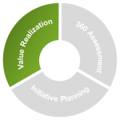
Segment Overview
Deploy
Leverage the components in the Microsoft Technology Connections sub-domain to support customer deployments.
Delivery guidance for the Value realization phase in VRF 1.0 is limited to the recommendations for use of specific components from the Component Library and a definition of the services that can be acquired from the BSC team.
Further content will be developed for VRF 1.5.
Value Realization
Adopt
Built on BSC services.
Measure
Leverage the Value Model defined in the Activity and Value Reporting component.
Notes:
The key objective of Value Realization is to help ensure that a deployment realizes the anticipated customer business value and benefits. Ongoing project reviews and an optimization process throughout the project will provide the basis for optimizing deployment activities.
Additional Value Realization Projects may be created using Microsoft approaches and methodologies to enhance adoption of systems and solutions. These may include for example, Accelerated Adoption for Value Realization, Persona/Work style Analysis, and Governance Planning. These projects may cover such scenarios as: Cloud Strategy, Productivity, Optimized Desktop, Mission Critical Platform, Business Intelligence, and Business Ready Security.
During this segment there are regular reviews of the measures that have been defined for the IT value model. There may be mutually agreed-upon course corrections, depending upon project execution success and effectiveness at achieving the anticipated business benefits.

Slide 45
Engagement Governance | Overview
Pre-Engagement
Contractual Obligations
Identify Primary Stakeholders
The Engagement Governance process uses a Service Delivery Plan as the core planning document for the Enterprise Strategy Program. This provides details on what is going to be accomplished, when it should be completed, and how it will be managed.
Progress is reported against the service delivery plan at regular intervals with updates to scorecard and detailed value realization measures. Beginning in Pre-Engagement a Stakeholder Management Plan is created and maintained throughout all engagement activities.
This process draws on the methods and templates defined in the Component Library for:
Service Delivery Planning
Customer Satisfaction Management (CoS)
Contractual Relationships
Relationship Objectives and Scope
Engagement Management
Stakeholder Management
Activity and Value Reporting
Launch
Launch Event
Define Objectives and Scope
Engagement Governance
Engagement Governance
Monthly Report
ESP Monthly Status Report
Update Service Delivery Plan
Quarterly Briefing
CIO Briefing
Update Service Delivery Plan
Renewal
ATU Planning
Update Service Delivery Plan

Slide 46
Engagement Governance | Outcome
Pre-Engagement
Objectives and Scope
Stakeholder Management Plan
Standard templates and processes are defined in the VRF Engagement Governance Delivery Guide and the Component Library:
Stakeholder Plan
Stakeholder, Relationships, Attitude, Actions
Conditions of Satisfaction
CoS Statements, Action Items, Owners
Relationship Objectives and Scope
Objectives, Scope
Service Delivery Plan
Scope ,Roadmap, Scorecard
Monthly Status report
Activities, Risks, Issues, Staffing, Value update
Value Realization Report
Scope, Value, Timeline
Change requests
Scope, Value, Impacts
Quarterly CIO Briefing
Activities, Risks, Issues, Staffing, Microsoft PoV awareness
Quarterly ATU Briefing
Activities, Risks, Issues
Launch
Objectives & Scope
Conditions of Satisfaction
Service Delivery Plan
Engagement Governance
Engagement Governance
Monthly Report
Service Delivery Plan
Monthly Status Report
Value Realization Report
Change Requests
Quarterly Briefing
Quarterly CIO Briefing
Quarterly ATU Briefing
Renewal
Renewed Contract
Service Delivery Plan
Value Realization Report

Slide 47
Value Realization Framework
Example of level 300 definition

Slide 48
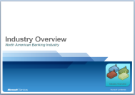
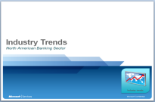
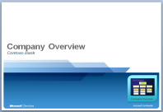
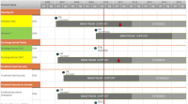
Context
Customer Insights
This activity is conducted prior to meeting with the customer.
Collect as much knowledge about the customer, their competitors and the industry to ensure customer familiarity when arriving on site.
Key Message Task
Review Industry
context
Review Organization
context
Review Microsoft
context
The back office will supply industry reporting to provide insights on current industry trends for business technology and as well as competitive analysis and industry trends.
This information can assist in understanding of the customer’s business drivers and how technology is used within the customers business vertical.
The back office reporting delivers customer information providing organization insights and financial data. Additional customer knowledge is usually obtained through meeting with the Microsoft Account Team (ATU). Creating an understanding of the stakeholders current roles and business strategies will assist in mapping the alignment of roles, strategies and responsibilities within the customers organization.
The back office report will supply the current, services and support contracts in affect and the Enterprise Agreement license inventory. Product roadmaps are included in the report. Additional product deployment and support issue information can be collected from ATU meetings and Customer Support Services (CSS) team meetings. Ensure understanding of Microsoft technology within the customer’s business.
Components
Subject Matter Content
Industry Context, Organization Context, Contractual Relations , Product Roadmaps

Slide 49
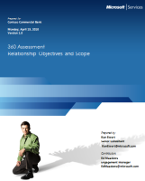
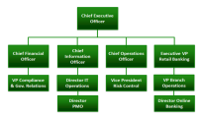
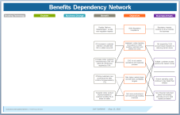
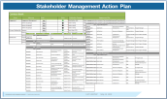
Context
Understand Customer Strategies and Priorities
Key Message Task
Get to know the stakeholders in the decision making process. Identify their style of decision making.
Capture what is driving the business decisions.
Establish sponsor expectations
Review customer’s IT Context
Identify customer concerns
Understand stakeholder decision making process
Capture Business Drivers, Objectives and Benefits
Review the objectives and scope and gain agreement for the 360 Assessment. Ensure the sponsor is aligned with the expected deliverables and approach. Capture any concerns of the sponsor.
Capture the portfolio of IT initiatives, assets, and any information that helps identify the constraints of the IT environment. Full capability assessments and IT services modeling are not completed until a later step.
An understanding of the customer’s business issues is critical to evaluating how they look at changes. Concerns around budget, resources and timelines are typical. Other issues may surface such as job security, political capital, and organizational recognition. A solid understanding of customer issues and concerns that will help drive future activities
Establish an initial understanding of stakeholder relationships, needs and objectives.
Validate roles and understand the business decision making processes. Identify key stakeholders and relationships that may influence the decision making process. Evaluate stakeholder positions pertaining to the engagement objectives.
Work with key stakeholders whose concerns are most important to satisfy. Begin capturing the Business Drivers, Objectives and Benefits. Create the foundation for aligning downstream recommendations with business objectives and strategies.
Components
Subject Matter Content
Stakeholder Management, Benefits Assessment, Risk Management

Slide 50
Value Realization Framework
Questions & Clarifications ?

